Slide 1

Sequence to sequence models
Picking the most likely sentence
deeplearning.ai

Slide 2







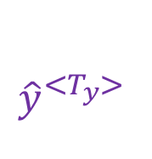


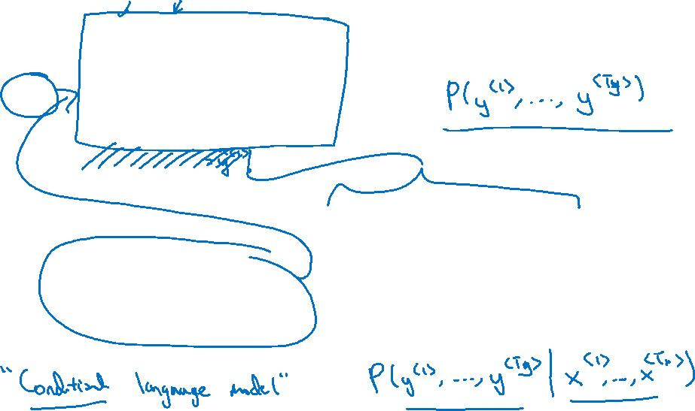

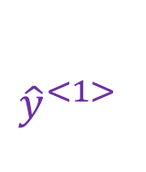


Machine translation as building a conditional language model
$${\hat{y}}^{<1>}$$
$${\hat{y}}^{<2>}$$
$${\hat{y}}^{<T_{y}>}$$
Language model:
$$a^{<0>}$$
$$⋯$$
$$x^{<1>}$$
$$x^{<2>}$$
$${{\hat{y}}^{<1>}}^{ }$$
$${{\hat{y}}^{<T_{y}>}}^{ }$$
Machine translation:
$$a^{<0>}$$
$$⋯$$
$$⋯$$
$$x^{<1>}$$
$$x^{<T_{x}>}$$

Slide 3
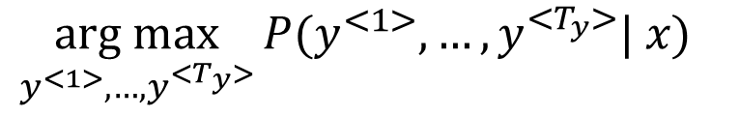

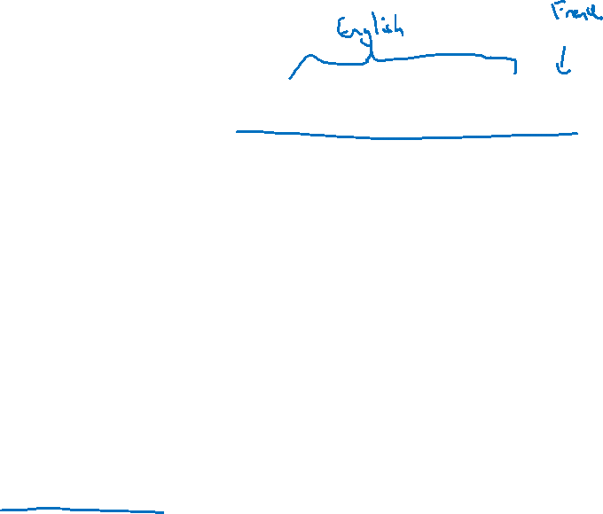
Finding the most likely translation
Jane visite l’Afrique en septembre.
$$P(y^{<1>},…,y^{<T_{y}>}| x)$$
Jane is visiting Africa in September.
Jane is going to be visiting Africa in September.
In September, Jane will visit Africa.
Her African friend welcomed Jane in September.
$${ \underset{y^{<1>}{,…,y}^{<T_{y}>}}{arg max}{P(y^{<1>},…,y^{<T_{y}>}| x) }}_{ }^{ }{ }$$

Slide 4




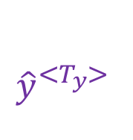

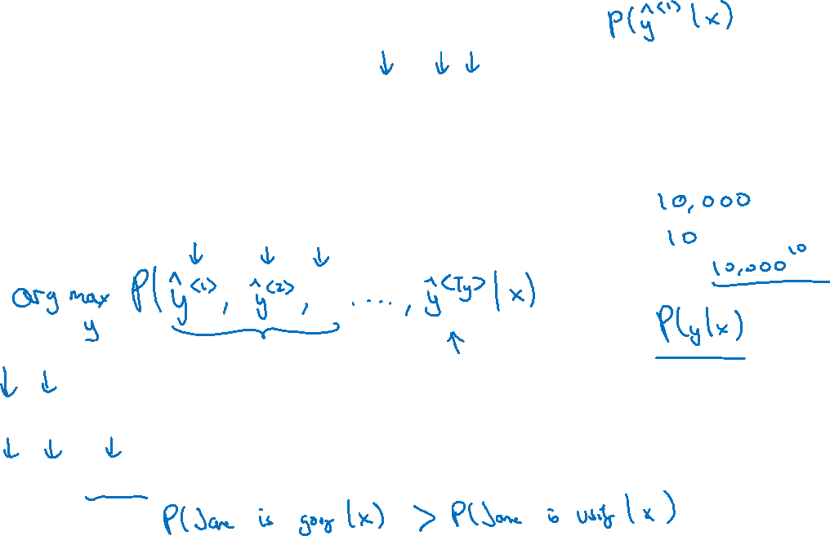
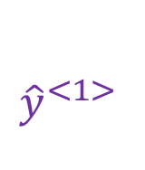
Why not a greedy search?
$${{\hat{y}}^{<1>}}^{ }$$
$${{\hat{y}}^{<T_{y}>}}^{ }$$
$$a^{<0>}$$
$$⋯$$
$$⋯$$
$$x^{<1>}$$
$$x^{<T_{x}>}$$
Jane is visiting Africa in September.
Jane is going to be visiting Africa in September.

